Slide 1

1’s TABLETS

Slide 2

UNIVERSAL ENERGY FIELD
UNIVERSAL
ENERGY FIELD

Slide 3

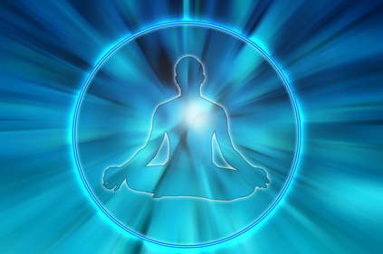
UNIVERSAL ENERGY FIELD
Everything that exists is permeated
by universal energy that connects
and nourishes all life.
It supports the life process in all it’s
aspects-the physical body, the function
of the emotions and mind and even the
spiritual life

Slide 4
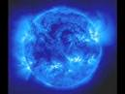
Universal Energy Field
Abides universal laws – Exceptional case – Healing ok
Manifests as universal mind.
Sum total of Mineral, Plant, Animal & Human kingdoms on planet Earth.
Every energy field (like earth and other planets) will have influents on other energy fields(To some extent).
Sahasrara experiences / oneness experiences.

Slide 5
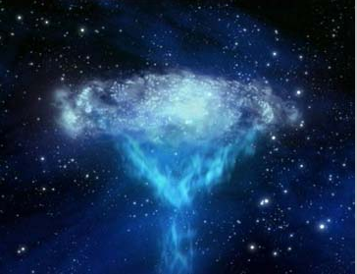
COSMIC ENERGY
COSMIC ENERGY
COSMIC ENERGY

Slide 6
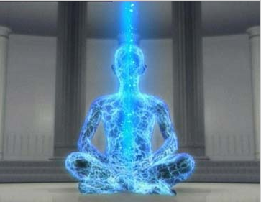
COSMIC ENERGY
Cosmic energy is around every where.
In Meditation, we get abundant
Cosmic Energy. It flows heavily through
all our Energy Tubes of Energy Body.
Cosmic Energy cleanses all Etheric
Patches due to its heavy flow. When
Etheric Patches are cleansed, we
come out of all our illness.
By intake of more and more Cosmic
Energy by more and more Meditation,
we come out of all physical
and mental illness.

Slide 7
Cosmic energy
Fuel for the soul system.
Abundant at hill tops, forests, natural environment & pyramid.
1hour meditation = 6hrs sleep(In energy terms).
Energy gain X Energy loss
Energy Wisdom Consciousness
kerlian’s photography - can detect.
Dousing
First 40 days to 3 months – energy receiving experiences.

Slide 8

OVERSELF
Kalasham pic

Slide 9

OVERSELF
OVERSELF ’ .. is the ‘ triune-self ’ consisting of the doer, knower and thinker parts. A do-er part comes down as ‘ under-self ’.
The OVERSELF is also called the ‘ psyche ’.
In meditation, we always see the OVERSELF as a pulsating triangle .. a 3-D prism.
Person in a triangle
or only triangle

Slide 10
OVER SELF
Top most position on earth plane.
Reference for total data.
Under self becomes another over self by expansion.
All questions related to over self – clarified - on self experience only (Meditation).
Kalasham in Meditation also represents over self.
Specks of consciousness – produced by over self – to form ECW units.
Thumb finger / Divine kingdom.

Slide 11
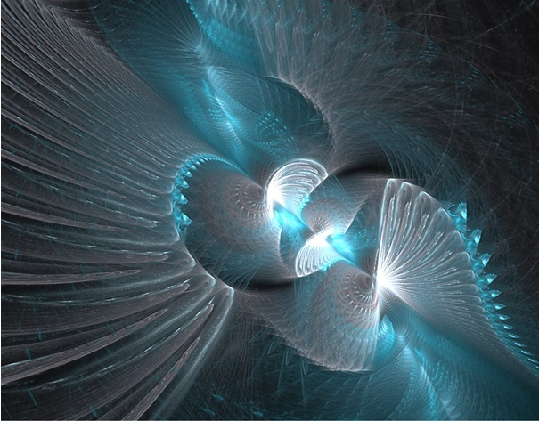
SOUL
SOUL

Slide 12

SOUL
We are not just our physical body; we are not just our mind; we are not just our intellect. We are the ATMA ... the SOUL ... the SELF.
It is the eternal speck of Consciousness and Energy and Wisdom.

Slide 13
Soul
Theoretical and practical understanding about the Soul (I am not the body ).
True / perfect detachment.
Roots (Soul) are more prior than branches(Body).
Soul scanning (through different kinds of spiritual experience)
Several incarnations wisdom (Data) to be considered.
Deficit at the level of Soul and intellect is directly proportional to problems on body and mind level.

Slide 14
Soul
Fear, ego, powers and laziness (Soul level).
Evolution of soul :
Infant soul
Baby soul
Young soul
Mature soul
Old soul
Transcendental soul
Infinite soul

Slide 15

THIRD EYE

Slide 16

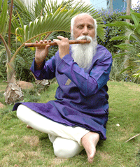
THIRD EYE
Breath is the great gate-way for the
third eye activation.
Third Eye is synonymous with the essence of soul.
- Brahmarshi Patriji

Slide 17
THIRD EYE
Opening X Perfection X Completion.
Purpose of life – perfectly understood.
By birth – open third eye – ignorant raising influences.
Prediction experiences - Power (ESP) – individual or community spiritual growth only.

Slide 18
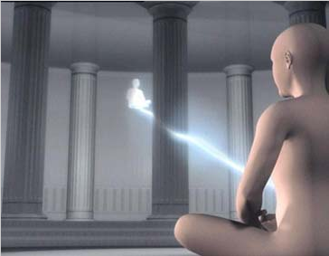
ASTRAL TRAVELLING
ASTRAL TRAVEL

Slide 19

ASTRAL TRAVELLING
In meditation, we do become ‘ anti-gravity bodies ’, and our astral bodies are released from the physical bodies, enabling us to travel freely in the higher worlds.

Slide 20

Astral travel
Inner vehicle runs on cosmic energy as fuel.
Meditation under pyramid more chances for astral travel.
Can tune our selves to other frequencies ( higher through astral travel).
Develops sheer common sense.
Part of Swadharm and Brahmanand.
All dreams are astral travels.
Impurities in mind (lack of enlightenment) – change projection.
Goal – most probable future projection (good or bad)

Slide 21

AURA
AURA

Slide 22

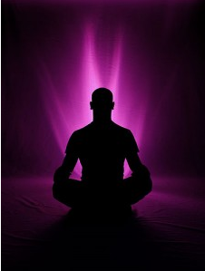
AURA
Aura is an electro magnetic field that surrounds the human body and every organism and object in the universe.
The colors of the aura can represent many things.
They can stimulate or depress, be constructive or destructive, and reflect positive or negative.
The aura reflects both the physical and spiritual aspects.
It provides information about health, personality, moods, and maturity.
As you read an aura you will see the colors closest to the body reflect the persons physical condition.

Slide 23

Aura
You will see the energies manifesting currently or very soon in the person’s life.
Kerlian photography.
In non – living things – Auric field – negative or positive – gain or loss – to be considered.
Able to see aura – power (ESP) – individual or community – spiritual growth only.
May not be a choice for every one in every life time( even though capable ).

Slide 24
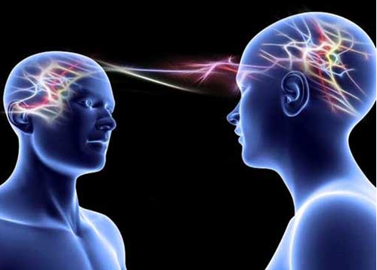
TELEPATHY
TELEPATHY

Slide 25

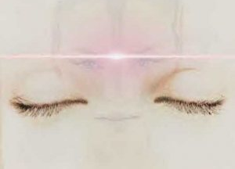
TELEPATHY
When Astral Masters are encountered... in deep meditation... Meaningful dialogues should be established.
Pointed questions should be put and answers received should be carefully remembered and noted.
All the dialogues and conversations happen through the means of Telepathy

Slide 26
Telepathy
Day to day experiences like .. facing the same person whom we thought just before meeting him.
In group interactions , prior discussions about a person who is just about to enter the group.
Unconscious patients – the only way to communicate – Betty Shine – Mind waves(Book).
Power of suggestion – for purposeful events through telepathy .
It’s a power – individual or community spiritual growth.

Slide 27

AKASHIK RECORDS
AKASHIC RECORDS

Slide 28
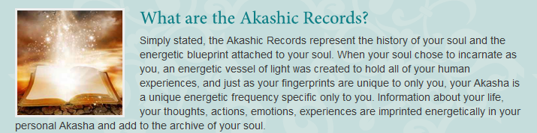

Slide 29
Akashic Records
Data base of the mother computer.
Can’t escape – minute things – stored in space & time.
Will get payment – every action did.
Astral footage.
Seers – use akarshic records for reference

Slide 30

REINCARNATION

Slide 31
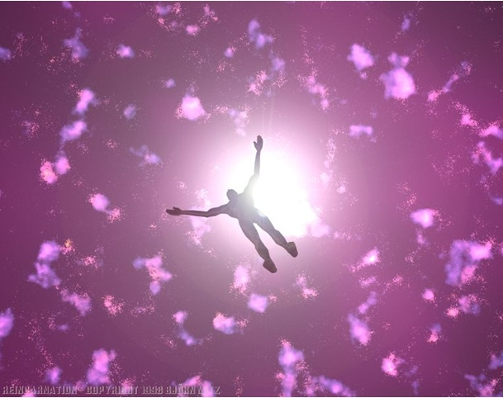
REINCARNATION
REINCARNATION
You cannot die ...
Death happens to the physical system, but not to you !...
You are not just the physical system !
You are the Energy-Knowledge-Consciousness system that has become a physical system.

Slide 32

Reincarnation
Different lessons in different in life times.
Michael theory – 350 to 400 life times .
Fear – clarity – powers – laziness
Qualities – different in different in each life time (Rajo, Tamo).
Past impressions – present life time – major cause of illness.
Realization – knowledge / wisdom – come out of illness.
Full moon intense Meditation (3 days) & reading books on past life – results in past life experience (if necessary).
Limited period incarnations, handicapped, M.R etc,. – by choice - part of learning.
Can be seen in Meditation, Dream, dizau etc,.

Slide 33
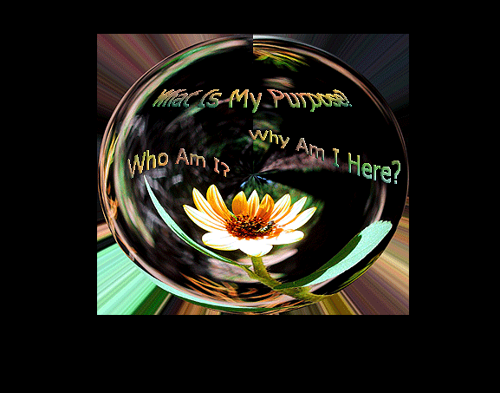
HYPNOTIC REGRESSION
HYPNOTIC REGRESSION

Slide 34


HYPNOTIC REGRESSION
Hypnotism is a very effective means of assisting a subject to relax deeply and enter a suggestible state where memories that are normally forgotten can be recalled with greater ease from the subconscious.
A great deal of evidence for the existence of past lives comes from hypnotic regressions.
It’s a kind of guided meditation.

Slide 35
Hypnotic regression
When group problem(involvement) arises.
Community spiritual growth challenges.
Emperor Ashoka used to do / undergo.
Phobias, fears and carried past.
To improve self confidence and self esteem.
To understand some relationships problems.

Slide 36


LAW OF KARMA

Slide 37

LAW OF KARMA
Past , Present & Future

Slide 38

Karma
Karma = Action (thought, speech, deed etc,. )
Food for soul
Types :
Past – Sanchita
Present – Prarabdha
Future – Agami
No Good & Bad – Progression theory (purogaman).

Slide 39

DUKHARAHITYAM
DHUKARAHITAM

Slide 40

Dhukarahityam
Basic enlightenment – beyond first 3 chakras.
Basic enlightenment = wisdom about death, third eye etc,.
Good difficulties X Bad difficulties.
We create our own difficulties (Spiritual )!
Planning - Future progression.
Prediction experiences & dreams – Indication for spiritual planning (Future).
Sat + chit + anand = Sachidanand

Slide 41
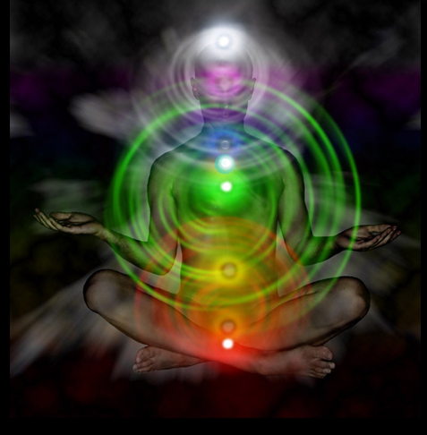
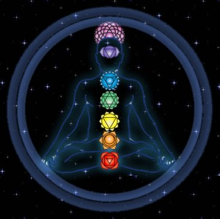
CHAKRAS
CHAKRAS

Slide 42

CHAKRAS
There are seven power centers in your body, called chakras.
The state of each chakra reflects the health of a particular area of your body. It also reflects your psychological, emotional and spiritual well-being.
Every thought and experience you've ever had in your life gets filtered through these chakra databases. Each event is recorded into your cells.

Slide 43

CHAKRAS
In other words, "your biography becomes your biology."
When chakra energy is blocked or misdirected, emotional and physical illness can arise.
Influence - Chakra - Energy – Knowledge
CHAKRA – AFFERMATION
Chakra – Gland – Body parts
Chakra – Color
Chakra – elements(Earth, water, etc,…)
Kerlian photography.

Slide 44
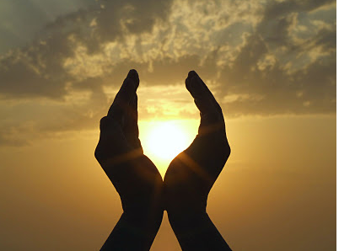
LOVE
LOVE

Slide 45

LOVE
Love is a spiritual mirror. It nourishes you, it integrates you, it makes you ready for the inner journey, it reminds you of your original face.
In moments of deep love there are glimpses of the original face, although those glimpses are coming as reflections.
Love gives you the taste of meditation.

Slide 46
LOVE
Any act which improves individual or community spiritual growth is called Love – The road less travelled by Scott Peck.
Love is opposite to laziness.
Laziness is “Fear to change the things”.
Universal Love - Unseen threads(Energy).
Primary Fevicol - Bind relation.
Towards all creatures – not to interfere with their journey.
If you give - you will get.

